Slide 1
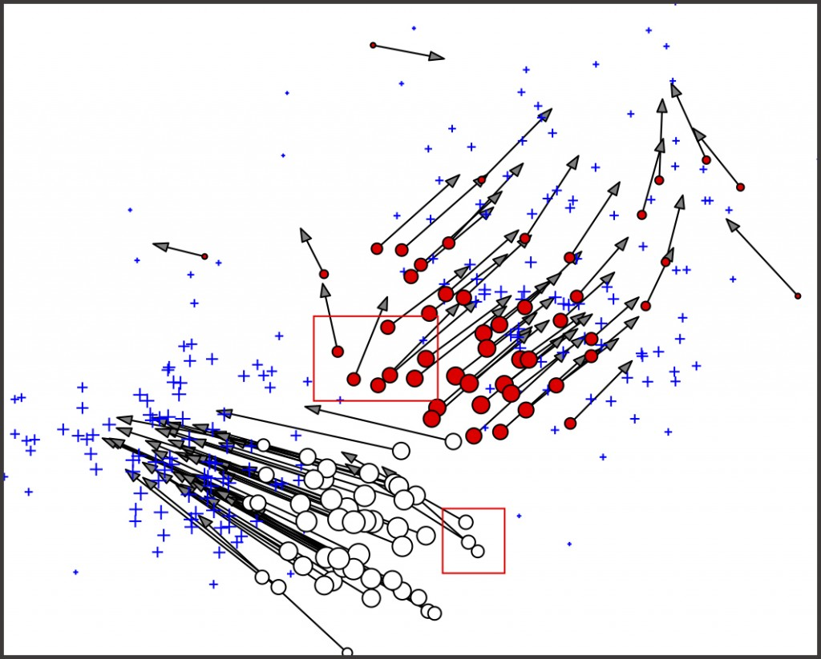

Machine Learning Applications in Physical Modeling and Simulation
Solomon Tessema
Nov. 2023
Professor David Inouye

Slide 2
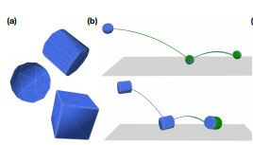
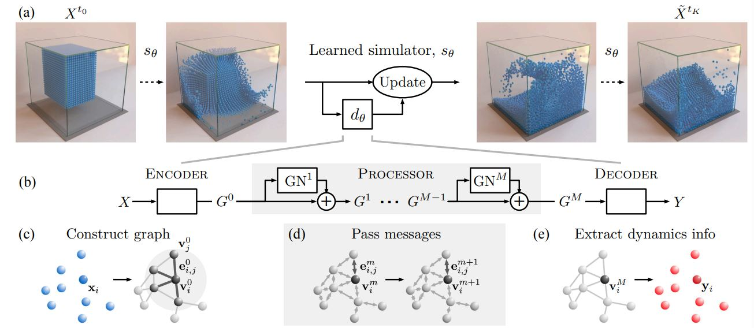
“The convergence of machine learning and physical modeling has ushered in a new era of possibilities, challenging established paradigms and offering innovative solutions to longstanding problems in physics and engineering.”
Quoted from Machine learning–accelerated computational fluid dynamics is a paper by Dimitrii Kochkov, et al

Slide 3
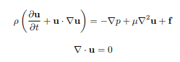
The Navier-Stokes equation
1,000,000 USD!
For solving the Navier–Stokes existence and smoothness problem. The Clay Mathematics Institute has called this one of the seven most important open problems in mathematics and has offered a 1 million USD prize for a solution or a counterexample.
The Navier-Stokes equations can be used to model a wide range of phenomena, such as weather, ocean currents, blood flow, aerodynamics, and more.
However, they are very difficult to solve analytically.
Solving the Navier-Stokes equation requires numerical methods or simplifying assumptions.

Slide 4
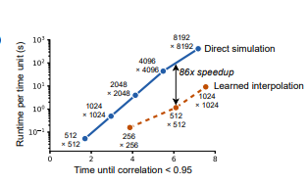
The machine learning algorithm embedded inside the CFD equation greatly improved the performance of computation.
Here, shown in the graph,
for a two-dimensional direct numerical simulation of a
turbulent flow, our algorithm maintains accuracy while
using 10× coarser resolution in each dimension, resulting in a ∼ 80-fold improvement in computational time
with respect to an advanced numerical method of similar accuracy

Slide 5
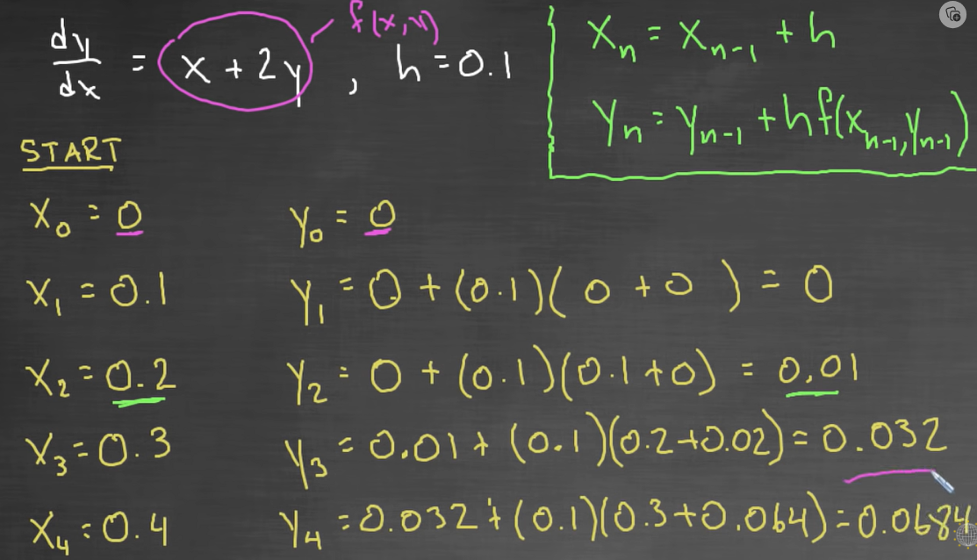

Slide 6
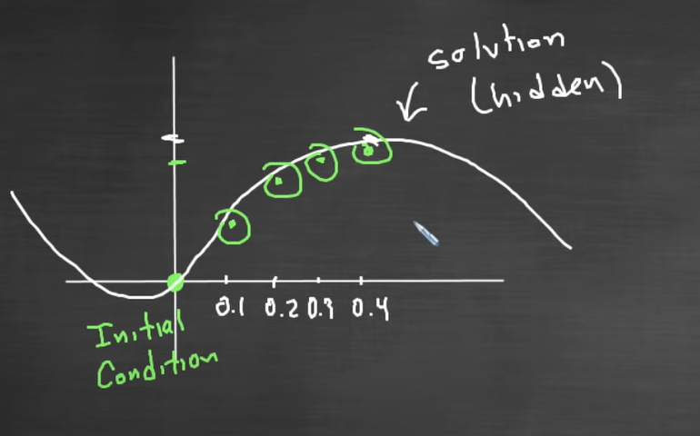

Slide 7
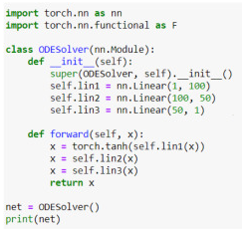
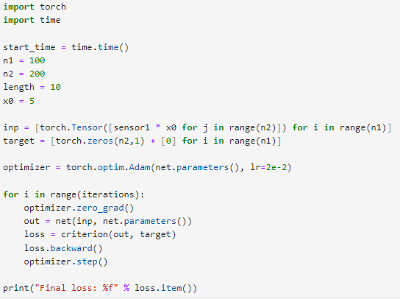

Slide 8
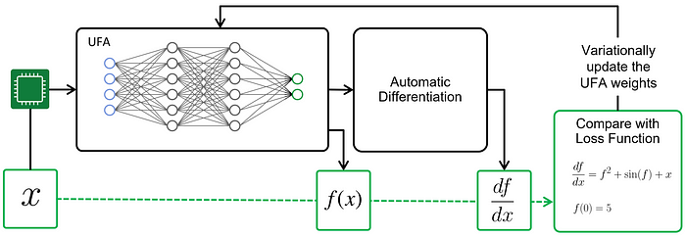

Slide 9
References:
Machine learning–accelerated computational fluid dynamics by Dimitrii Kochkov, Jamie A. Smith, Ayya Alieva, Qing Wang, Michael P.Brenner, and Stephan Hoyer
Source code for the models, including learned components, and training and evaluation datasets are available at GitHub (https://github.com/google/jax-cfd).

